Slide 1
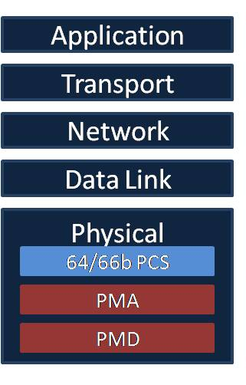
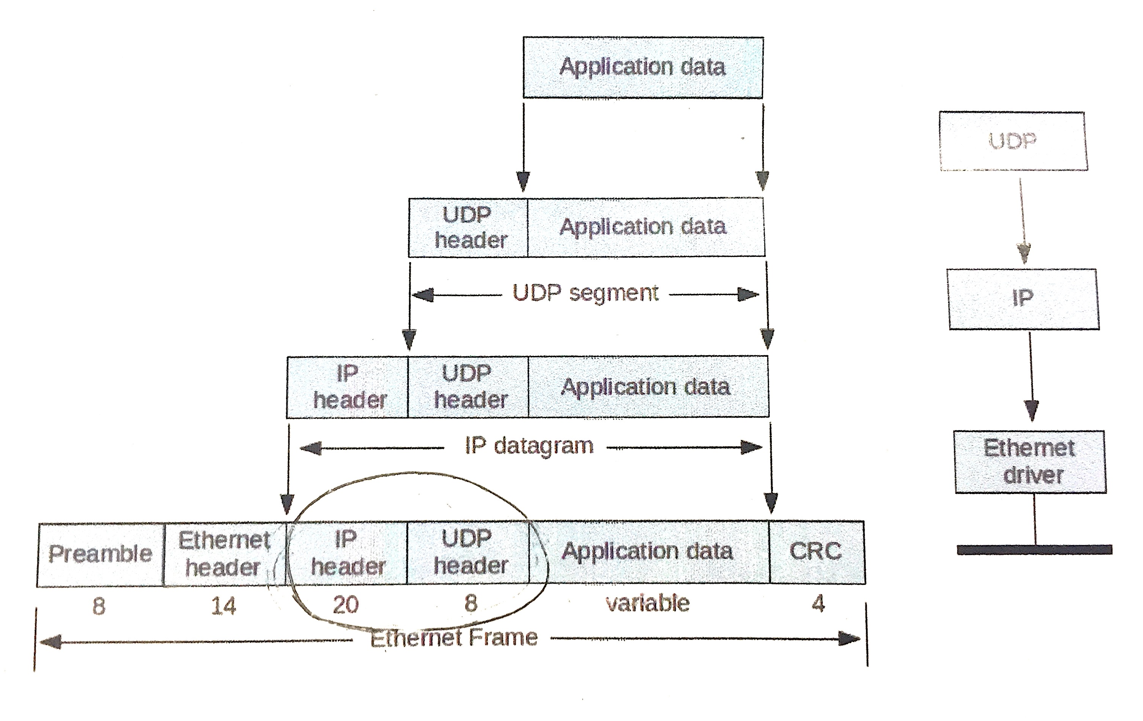
Day 1 – Networking Stack
Understanding the networking stack and the inter-packet delays.
A strong background in physics could be required to solve hardware questions in computer engineering.
Day 2 – Scrambler Algorithm
A simple algorithm can be used to meet great physical restrictions!
G(x) = 1 + x³⁹ + x⁵⁸
Day 3 – Encoding
Sending information through the network requires overhead information in order to assure that data arrives safely.
(Ties in well with Fred Schneider’s lecture on fault tolerance)

Slide 2
Day 4 – Decoding and Descrambler
Decoding and descrambling are the inverse of scrambling and encoding.
It is important that the state of the scrambler is passed back and forth like a key.
In real life, there are a lot more unexpected bugs than what is theoretically described.
Major Takeaway
Jon Kleinberg’s talk focused on understanding large social networks and how engineers are making design decisions for the future. However, social networking is fundamentally built off of advances in networks and the internet. Both technically and social advances are needed in order to build for a brighter future.

